Slide 1


ΕΘΝΙΚΟ ΜΕΤΣΟΒΙΟ ΠΟΛΥΤΕΧΝΕΙΟ
ΣΧΟΛΗ ΗΛΕΚΤΡΟΛΟΓΩΝ ΜΗΧΑΝΙΚΩΝ & ΜΗΧΑΝΙΚΩΝ ΥΠΟΛΟΓΙΣΤΩΝ
ΤΟΜΕΑΣ ΤΕΧΝΟΛΟΓΙΑΣ ΠΛΗΡΟΦΟΡΙΚΗΣ & ΥΠΟΛΟΓΙΣΤΩΝ
Πλατφόρμα βασισμένη σε Οντολογίες για τη Διαχείριση
Υποδομής Κέντρου Δεδομένων, με Προγραμματιστικό Έλεγχο
Ιωάννης Α. Ανδρουλιδάκης
Επιβλέπων καθηγητής: Νεκτάριος Κοζύρης
Εργαστήριο Υπολογιστικών Συστημάτων

Slide 2
Agenda
Motivation
Design
Architecture
Demo!
Discussion

Slide 3
Agenda
Motivation
Design
Architecture
Demo
Discussion

Slide 4
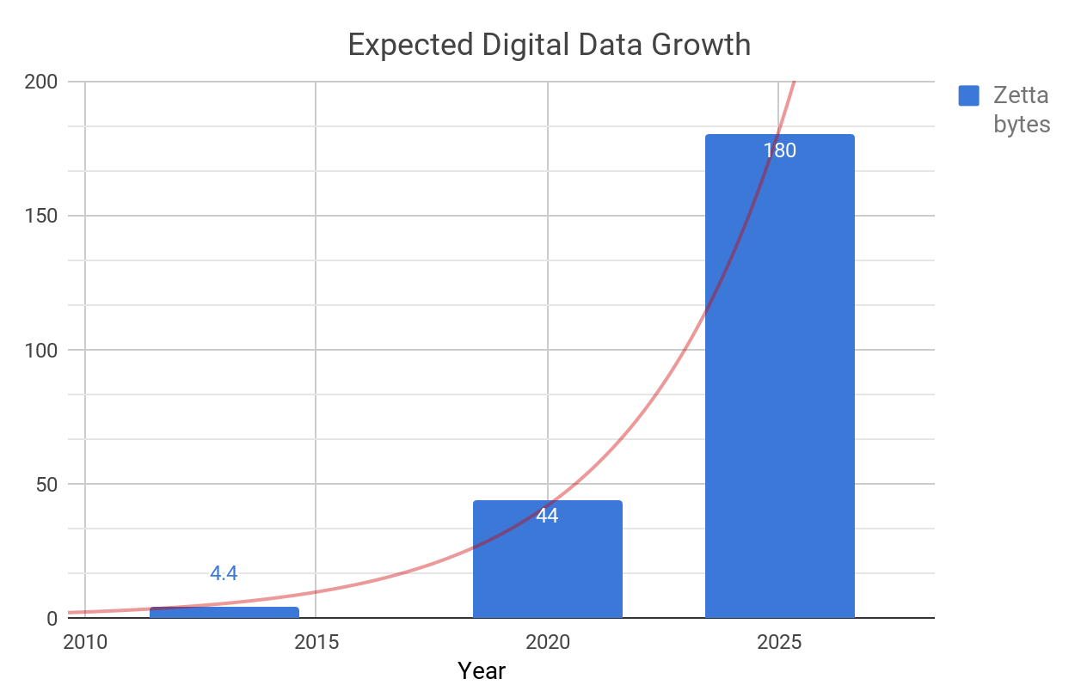




The Zettabyte era
~ 2.5 exabytes / day
Human Data
Machine Data
~ 200M e-mail deliveries / min
~ 2M Google searches / min
~ 35K Tweets / min
~ 300h of Youtube videos uploaded / min
IDC FutureScape: Worldwide IT Industry 2017 Predictions
Notes:
2.5 billion GB / day
90 % of world data is created in last 2 years

Slide 5
Storage Challenge
The IT community faces the challenge of efficiently storing and processing large data sets of unstructured data (Big Data)
Approaches:
Software-based
Scale-out, distributed storage platforms
Hardware-based
Extension of physical infrastructure
Goals:
Scalability
Availability
Consistency

Slide 6

Data Centers
Large scale facilities housing computer systems and associated components
Unified structure, interconnected resources, automated operations
Storage, management and distribution of data within an enterprise
Cloud Computing
Distributed Storage platforms
Virtualization environments
IoT & Mobile applications
Google Data Center
Notes:
What is a Data Center?
Rooms, servers, racks , power supplies, networking infrastructure, cooling systems
Data repository,

Slide 7
Assumption
Systems and processes can, and will inevitably fail. Each component must be monitored to prevent failures and reveal interdependencies inside complex systems.
Notes:
Human error, less frequently hardware
Undetected misbehavior or failure (e.g. 200 OK web server)
Wrong capacity planning (x2 clients than expected) → test application at scale
Slowly building over time failures due to interdependencies, single-point failures may lead to total failure

Slide 8
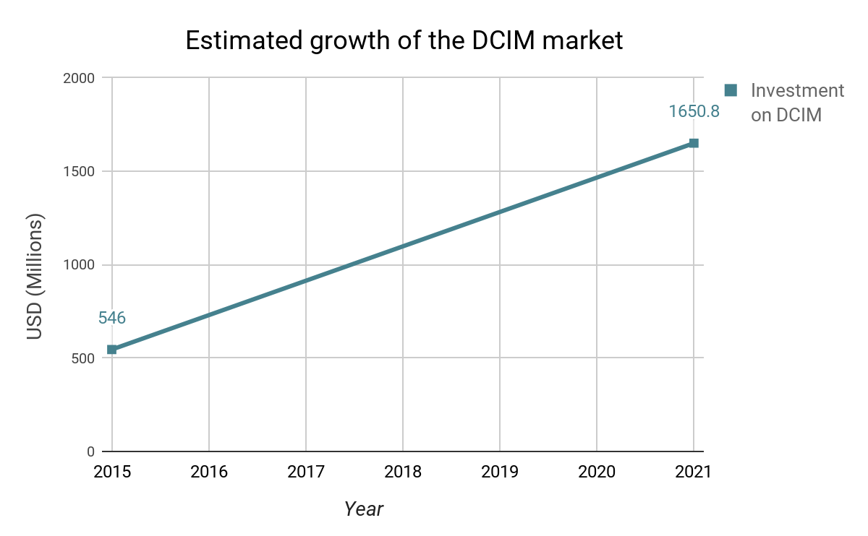

DCIM
High density
Data Center Infrastructure Management
“A set of tools that help supervise and manage assets inside a Data Center”
Increased complexity
Heavy workloads
Zion Market Research - DCIM Market by Solution, 2016
Notes:
Give short definition
Data placement moved to Cloud, on-premise Data Centers, SaaS / storage monitoring προϊόντα στο industry(πχ Red Hat)
Enterprise is investing on DCIM software, necessity for managing IT workloads
Emerging branch of IT ,Inseparable component of the IT stack

Slide 9

Existing solutions
Narrow spectrum, explicit definition of domain-specific semantics
Static modeling of entities (classes, strong typing)
Limited flexibility and customizability
Closed source, proprietary (black-box deployment, vendor lock-in)
Notes:
Static modeling → conservative approach
Of course there are some open-source alternatives, like Zabbix, Racktables and Netbox
However, they also suffer from static modeling, while focusing on a specific target system

Slide 10
Agenda
Motivation
Design
Architecture
Demo
Discussion

Slide 11
Rationale
Develop an elastic framework that does not rely on the semantics of the target system (content-agnostic)
Supervise diverse target systems under the same Web Interface
Deliver real-time monitoring and visualization services, adjusted to end-user needs
Employ open-source, scalable, future-proof technologies
Communicate over clean JSON web APIs

Slide 12
What is OntoMon ?
An interoperable monitoring platform that integrates
with heterogeneous systems and treats all entities uniformly
OntoMon
Integration
Integration
Integration
Target System 1
Target System 2
Target System N
. . .
Notes:
OntoMon is an independent platform that sits on top of diverse target systems, providing monitoring services.

Slide 13
OntoMon’s Object Model
The most abstract we could go: Objects
Describe the target system in a JSON-formatted Ontology
standard structure
Everything is represented as an object
mutable content
No need to understand specific info about the underlying system
Merely interact with well-defined interfaces
Notes:
Ontology → formal and well-structured description of the domain of interest

Slide 14




Monitoring intuition
Visualization & Alerting
Real-time Monitoring Platform
Metrics Analysis
Metrics Storage
Metrics Collection
System1
System2
System3
System4
Data
Center
System5
System6
...
SystemN

Slide 15


Distinction of Roles
OntoMon requires a System Integrator for domain-specific configuration
uses
End
User
Web UI
OntoMon
informs
configures
monitors
deploys
System
Integrator
Target System
Notes:
System integrators understand the structure of OntoMon and are aware of the administration needs regarding the target system.
Accordingly, they adjust or extend specific parts in the core code of OntoMon with domain-specific definitions, (Ontology, Observer, Icinga) following the given interfaces or schemas. This leads to a fully-adaptable system that adjusts to user needs. ROLES not HUMANS

Slide 16
Agenda
Motivation
Design
Architecture
Demo
Discussion

Slide 17








OntoMon Architecture
Graph
Composer
End User
Graph
Composer
OntoMon
Web UI
embeds graphs
OntoMon
Web UI
Upper
Layer
Clients
retrieves
metrics
queries
HTTP JSON API
responds
commits metrics
retrieves metrics
OntoMon
Observer
Storage
Backend
OntoMon
Observer
Metrics
Collector
Storage
Backend
Metrics
Collector
OntoMon
Server
posts
updates
OntoMon
Server
Monitoring
Core
Middle
Layer
collects
metrics
System Integrator
HTTP JSON API
formally describes
Ontology
Target System
Ontology
Base
Layer
Target System
Infrastructure

Slide 18

Base Layer - JSON Ontology
Graph
Composer
OntoMon
Web UI
End User
A formal, concise and well-rounded description of the target system
Expressed in JSON format
Lightweight, human-readable data representation
Maps real-world monitored assets to abstract OntoMon objects
Flat object pool, no nested definitions
Upper
Metrics
Collector
Storage
Backend
OntoMon
Observer
OntoMon
Server
Middle
System
Integrators
Target System
Ontology
Ontology
Base
Notes:
Essentially an array with JSON entries → simplified Ontology - technically a formal vocabulary
Why JSON ? Supported by all modern browsers
Simple, yet performant in large scale → eliminate conflict definitions

Slide 19



Base Layer - JSON Ontology Schema
Ontology Object
{ "uuid": "d99c5f76-1027-4502-8845-255fd393f85b", "name": "Debian-Server-1", "label": "Server", "file": "Server.svg", "parent": "d1fc8011-bbfc-47fd-9c14-766acba617dd", "info": { "description": "Server asset", "brand": "DELL", "model": "PowerEdge 2950", "chassis_type": "Rackmount", "color": "silver", "form_factor": "2U", "64_bit_support": "yes", "num_psu": 2, "OS": "Debian 8 Jessie" } }
Target System
Ontology.json
Notes:
Explain attributes of each Ontology object
System integrators generates the Ontology.json file and uploads it to the OntoMon Server
Example

Slide 20
Middle Layer - OntoMon Observer
Graph
Composer
OntoMon
Web UI
End User
Custom Python middleware (daemon)
Domain-specific logic and reasoning
General-purpose extendable core
Retrieves time-series data and concludes on the current state of monitored assets
Triggers notification mechanism and implements alerting API
Upper
OntoMon
Observer
Metrics
Collector
Storage
Backend
OntoMon
Observer
OntoMon
Server
Middle
System
Integrators
Target System
Ontology
Base
Notes:
Custom middleware to ‘glue’ bottom and upper layer → must be customized/extended by systems integrator
Central component that implements the logic and control of the monitoring procedure
Source of OntoMon’s notification chain → concludes on current state of infrastructure and dispatches state updates
Runs in the background as a daemon

Slide 21
Middle Layer - OntoMon Alerting API
Update.json Object
{
"uuid": "d6f24676-c0dc-4f8a-a29f-d1031e5fe8d2",
"timestamp": "2017-06-23 14:09:25",
"state": "OK",
"metrics": {
"total_capacity": "50GB",
"disk_used_pct": 40,
"disk_free_pct": 60
},
"type": {
"element_class": "indicator",
"attribute_name": "fill",
"attribute_value": "green"
},
"description": "No issues were detected."
}
Every status update is represented by an Update.json Object
Valid values for state attribute:
OK
WARNING
CRITICAL
Type attribute determines the visualization of the update inside the Web UI
Notes:
Most recent snapshot of asset operation

Slide 22
Upper Layer - OntoMon User Interface
End User
Dynamic Angular web app generated on-the-fly
End-to-end visualization of the target
system based on Ontology.json
Real-time notifications and automatic
view updates
Real-time performance graphs
Programmatic control of SVGs associated with monitored assets
Graph
Composer
OntoMon
Web UI
OntoMon
Web UI
Upper
Metrics
Collector
Storage
Backend
OntoMon
Observer
OntoMon
Server
Middle
System
Integrators
Target System
Ontology
Base
Notes:
Typescript = superset of JavaScript, Google, actively developed, all-around, structured code, strong CLI, webpack to bundle
Content agnostic → general-purpose manipulation of Ontology objects, aware of inner APIs and structure, visualizes diverse target systems, as long as a proper Ontology exists. Programmatically controls UI generation
Retrieves files from Server - uses D3.js, Observables, Events, HTTP, Routing → streamlines changes, delivers real-time notifications regarding status updates

Slide 23
Upper Layer - OntoMon UI internals
contains
Ontology Tree
Browser DOM Tree
Object0
SVG
Element0
Object1
SVG
Element1
BFS Traversal
Object2
Object3
SVG
Element2
SVG
Element3
Object4
Object5
Object6
SVG
Element4
SVG
Element5
SVG
Element6
Notes:
The Angular application generates HTML elements and appends them to the browser DOM
Inside the Angular components, the UI of OntoMon dynamically loads the SVG elements (XML), performs calculations and appends them to the same DOM Tree as leaf HTML nodes
Each SVG element represents a monitored asset → nested SVG structure

Slide 24
Agenda
Motivation
Design
Architecture
Demo!
Discussion

Slide 25
Demo - Testbed environment
Qemu process
10.0.0.3
Qemu process
Qemu process
10.0.0.2
10.0.0.1
U
Icinga agent
U
Icinga agent
U
Icinga agent
User
Space
K
K
K
H
H
H
Tap0
Tap1
Tap2
Kernel
Space
Bridge
Physical
Hardware
Notes:
3 Qemu processes, custom bridged networking environment

Slide 26
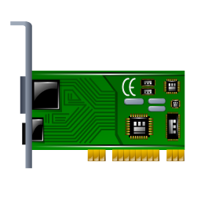



Test case 1 → Monitoring physical infrastructure
Graph Composer
OntoMon Web UI
Hierarchy
End User
Root
User
Space
Metrics
Collector
Storage Backend
OntoMon
Observer
OntoMon
Server
World
System
Integrator
Data Center
Rack
U
Icinga agent
U
Icinga agent
U
Icinga agent
Ontology
K
K
K
Server
H
H
H
H
Disk, Memory,
CPU, NIC
Kernel Space
Physical Hardware
Notes:
Domain-specific UI without domain-specific code

Slide 27
What to monitor ?
Hierarchy
Root
HW Asset | Domain-specific Metric
Disk | Capacity, Usage, IO stats
CPU | Average load, Usage
Memory | Capacity, Usage, Swap
NIC | Ping, SSH, RX/TX
World
U
Icinga agent
Data Center
K
Rack
H
Server
System
Integrators
Disk, Memory,
CPU, NIC
Notes:
Describe every metric we monitored
→ Defined specific CheckCommand and Service Objects in Icinga
→ Defined specific handler functions in the Observer

Slide 28

Test case 2 → Monitoring software-defined platform
Graph Composer
OntoMon Web UI
Hierarchy
End User
Root
User
Space
Metrics
Collector
Storage Backend
OntoMon
Observer
OntoMon
Server
World
System
Integrator
Data Center
Cluster
Icinga agent
Icinga agent
Icinga agent
U
U
U
Ontology
ceph-osd daemon
ceph-monitor daemon
ceph-osd daemon
Nodes
K
K
K
H
H
H
Ceph Monitors,
Ceph OSDs
Kernel Space
Physical Hardware

Slide 29
What is Ceph ?
An open-source, distributed, software-based storage platform
Designed to scale, self-managing, no single point of failure
Replicates and rebalances data across multiple nodes
Pools
Placement Groups
Objects
OSD
Object Storage Daemons
→ store and serve objects to clients
M
Monitors
→ Orchestration and decision making

Slide 30
What to monitor ?
Hierarchy
Root
SW Asset | Performance Metric
Ceph Cluster | Health, Capacity, Usage, IO, Throughput, Objects, state of PGs, Per pool statistics
Ceph OSD | State(UP,DOWN,IN,OUT)
Ceph MON | State(UP,DOWN), quorum
Icinga agent
World
U
ceph-daemon
Data Center
K
Cluster
H
Node
Ceph daemons
Notes:
Describe every metric we monitored
→ Defined specific CheckCommand and Service Objects in Icinga
→ Defined specific handler functions in the Observer

Slide 31
Agenda
Motivation
Design
Architecture
Demo!
Discussion

Slide 32






Questions ?

Slide 33

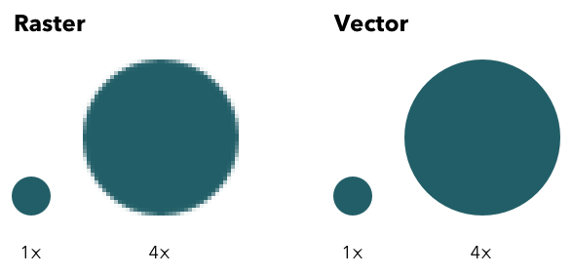
Base Layer - Why SVG?
Scalable Vector Graphics
W3C open standard
XML language → accessibility and programmatic control
Mathematical formulas between points
No explicit definitions of pixels
File size efficiency
Display-independent format, smooth rendering without losing quality
Notes:
Raster image 200x200 → 400 pieces of information
-- Standard number of pixels, Zooming is blurry as extra pixels are randomly colored
Vector image 200x200 → only 4 points(corners) + mathematical formula to connect dots
-- First find size, then apply the same mathematical formula producing the same graphic

Slide 34
Base Layer - Programmatic control over SVGs
Problem: Dynamically handle SVG elements inside the User Interface
Introduce custom inline attribute in SVG code for later transformations
Specify a certain element to visualize corresponding alerts
SVG requirements
Example of SVG file of Ontology
Slot:
“<upper-left-point1-x>,
<upper-left-point1-y>,
<width>,
<height>”
Indicator Element:
class: "someClass",
attributeName: "someAttribute",
attributeValue: "someValue"
<svg xmlns="http://www.w3.org/2000/svg" width="100%" height="100%" slots="15,25,200,50,45,75,240,60">
<g>
<!-- Your custom SVG markup here -->
...
<circle class="indicator" fill="#62c36e">
</circle>
</g>
</svg>
Notes:
Transition, Scaling issues

Slide 35


Middle Layer - Icinga Cluster
Icinga Master
Zone
commits
metrics
Zones
Endpoints
reports
performance,health
metrics
reports
performance, health
metrics
pushes
config objects
Icinga Client
Zone
Icinga Client
Zone
collects
metrics
collects
metrics

Slide 36
Middle Layer - InfluxDB internals
Value
HTTP GET http://influx-host:8086/query?
{
"database": "performance_metrics",
"retentionPolicy": "one_day", "points": [{
"name": "disk", "tags": {
"server": "Debian-Server-1",
"unit": "1"
}, "timestamp": "2015-03-16T01:02:26.234Z", "fields": {
"total_capacity": "50GB",
"disk_used_pct": 40,
"disk_free_pct": 60
}
}]
}
Measurement
Time
Data point
Time series
Tag set
InfluxQL query example
SELECT * from "disk"
WHERE "server" = "Debian-Server-1"
AND time > now() - 1h
ORDER BY time DESC
Field set
|measurement|,|tag_set| |field_set| |timestamp|

Slide 37
Middle Layer - InfluxDB internals
Updates and deletes are rare
Chronological order, recent timestamps
No duplicate data is stored → Improved conflict resolution
Aggregate large data sets, don’t focus on single points
Efficient handling of complex time queries
Availability
Consistency
Availability
Consistency
vs
“No one point is too important”
Notes:
Redundancy → lose a node without losing data
Distribution → share of total workload

Slide 38

Middle Layer - OntoMon Observer internals
Observer.py
Services.py
Validator.py
Dispatcher.py
Calls
Queries HTTP
Storage
Backend
System
Integrators
Responds HTTP
OntoMon
Server
Returns
Calls
Sends
Returns
Dispatches Update HTTP
Driver module
Defines CLI args
Checks OntoMon status
Calls services
Constructs Update.json
Calls dispatcher
Defines asset-specific monitoring services
Queries and parses
time-series data
Applies threshold-
based checks
Validates format of Update.json objects
Uses regular expressions to check uuid, timestamp
and state values
HTTP module
GETs Ontology.json from OntoMon Server
POSTs Update.json objects to the OntoMon Server
Notes:
Services.py and Observer.py need to be properly adjusted/extended by the system integrator
General purpose implementation, must be customized to fulfil its goal
Explicit definition of Services, Thresholds, CLI arguments regarding monitored assets and logic of status updates

Slide 39


Middle Layer - OntoMon Server internals
OntoMon Clients
OntoMon Server
Web Endpoints
HTTP
JSON API
OntoMon Web UI
Single Thread
Web Endpoint | Supported Methods
/upload | POST
/resources | GET
/updates | GET,POST
/log | GET
HTTP
JSON API
OntoMon Observer
Event Loop
HTTP
JSON API
System
Integrators
Update Queue
Notes:
Each client connection fires an event
The single thread handles these events (event loop)
If no IO is needed, the single thread processes the requests and responds
If IO is needed, a separate thread fulfills the request when data arrives

Slide 40
Upper Layer - OntoMon UI structure
Validator
Service
Parser
Service
HTTP
Service
Sidenav
Component
Toolbar
Component
Component-based
Architecture
Components inject
Services
Components follow an MVC-like pattern
Asynchronous events
Direct access to DOM
App
Component
Tree
Component
Data
Service
Router
Overview
Component
Assetview
Component
Log
Component
Settings
Component
Poling
Service
Graph
Component
Metrics
Component

Slide 41
Upper Layer - Grafana internals
Graph Composer
OntoMon Web UI
Well-
known
URL
serves
graphs
embeds graphs
Web client
retrieves
metrics
from
<iframe [src]="http://grafana-server:3000/ontomon-dashboard/
&panelId=5&from=now-30&to=now&var-asset=Debian-Server-1">
</iframe>
Storage Backend
Time series
Database
Template variable
Notes:
Avoid double dashboards, when monitoring servers on the same metrics

Slide 42
Upper Layer - OntoMon UI SVG controller
Parent SVG
find parent
element in DOM
Child SVG
find first available slot
Current SVG
element
Some SVG
element
Some SVG
element
Current SVG
element
Current SVG
element
Scale + Transition transformations
Slot:
<x>, <y>,
<width>, <height>
Notes:
Nested SVG elements inside DOM
Place each SVG element after scaling and transition transformations

Slide 43
Base Layer - Target System
Graph
Composer
OntoMon
Web UI
End User
The actual computing system that is about to be monitored
Consists of software- and hardware-defined assets
We assume hierarchical organization of entities
At some level or depth contains servers
Upper
Metrics
Collector
Storage
Backend
OntoMon
Observer
OntoMon
Server
Middle
System
Integrators
Target System
Target System
Ontology
Base

Slide 44
Middle Layer - Metrics Collector
Graph
Composer
OntoMon
Web UI
End User
Icinga → Fork of Nagios
Distributed collection of real-time performance metrics
Periodically export performance data to storage backend
Check plugins (scripts)
Agent-based monitoring (Master, Clients)
Upper
Metrics
Collector
Storage
Backend
OntoMon
Observer
Metrics
Collector
OntoMon
Server
Middle
System
Integrators
Target System
Ontology
Base
Notes:
Used Icinga as a collector agent, despite it also delivers monitoring capabilities
Real-world production system
Designed to perform in large scale
Easy to define both software- and hardware-based Plugins

Slide 45
Middle Layer - Storage Backend
Graph
Composer
OntoMon
Web UI
End User
InfluxDB → native time series Database
Efficient storage of large scale data
SQL-like query language (InfluxQL)
Exports HTTP API for remote client communication
Single- or multi-node deployment
Defines retention policies
Upper
Storage
Backend
OntoMon
Observer
Metrics
Collector
Storage
Backend
OntoMon
Server
Middle
System
Integrators
Target System
Ontology
Base
Notes:
Redundancy → lose a node without losing data
Distribution → share of total workload
Replication + expiration date

Slide 46
Middle Layer - OntoMon Server
Single-threaded, lightweight web server built on Node.js
Holds current state of assets
Orchestrates communications and delivers data across layers
Understands the alerting OntoMon API
Serializes and serves notification objects at a well-known web endpoint
Generates log file
Graph
Composer
OntoMon
Web UI
End User
Upper
Metrics
Collector
Storage
Backend
OntoMon
Observer
OntoMon
Server
OntoMon
Server
Middle
System
Integrators
Target System
Ontology
Base
Notes:
Fast and easy deployment
High performance given the application
Lightweight scalable - compiles JavaScript directly into native machine code
Easy to write API handling code

Slide 47
Upper Layer - Graph Composer
Graph
Composer
OntoMon
Web UI
End User
Grafana - metrics and analytics dashboard
Composes rich, interactive time-series graphs
Supports various storage backends
Serves panels at well-known web endpoint
Client-side rendering
Graph
Composer
Upper
Metrics
Collector
Storage
Backend
OntoMon
Observer
OntoMon
Server
Middle
System
Integrators
Target System
Ontology
Base
Notes:
Dedicated component for graphing → separation of concerns, distribution of workload, abstraction
Plug-and-play deployment : set up input source, configure dashboards and panels, embed via well-known URL
Most of the processing workload happens at the side of the server, not the client → web page info is dynamically loaded
Optimized for time-series, aggregation + filtering capabilities, wide range of supported visualizations

